Slide 1
Weed Management
in the Age of
New Technology
Sarah Lancaster
Assistant Professor and Extension Specialist – Weed Management

Slide 2
OUTLINE
Site-Specific Weed Management
Targeted Spraying
Other possibilities

Slide 3
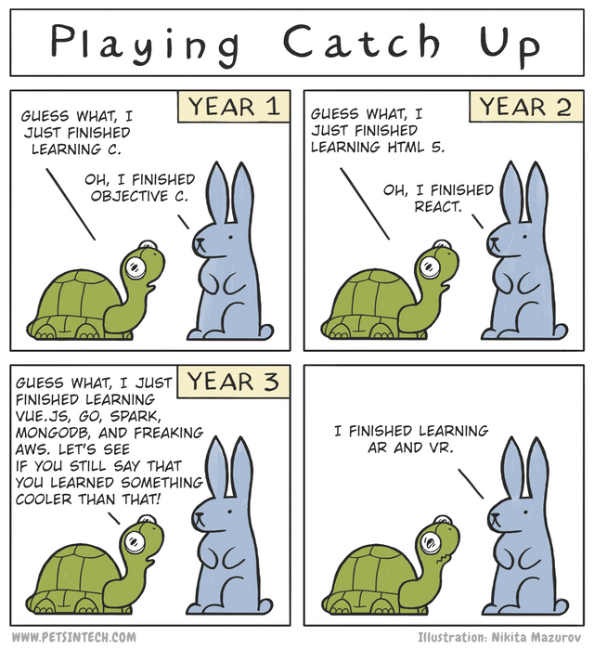
What is
Site-Specific weed management?
“Applying the right input on the right weed at the right time” Reddy & James 2018
  Environmental benefits for society
  Economic benefits for farmers
https://www.reddit.com/r/ProgrammerHumor

Slide 4

TARGETED SPRAYING
Technically, not “spot spraying”
Directed spray application, typically labor intensive
Also not a “prescription” application
Based on map derived from pre-existing information

Slide 5
What targeted spraying system(s) are you aware of?

Slide 6









Targeted Spraying Systems
6

Slide 7
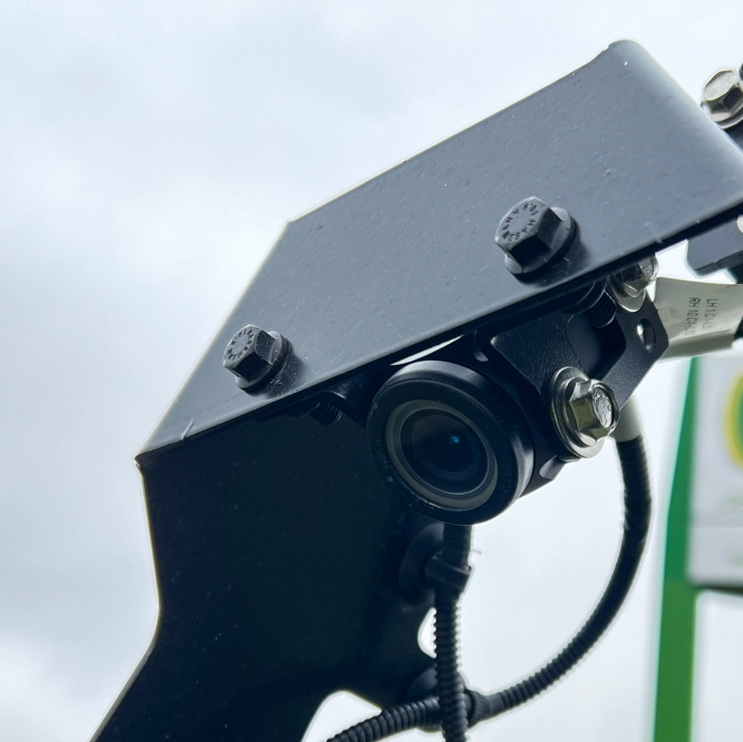
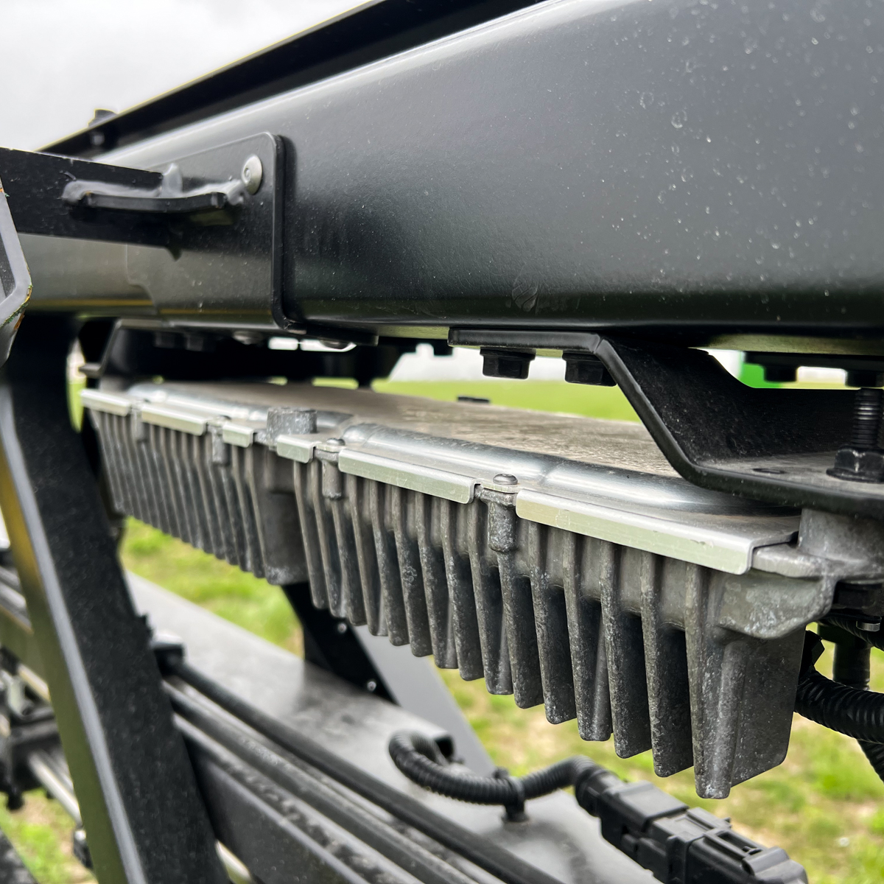
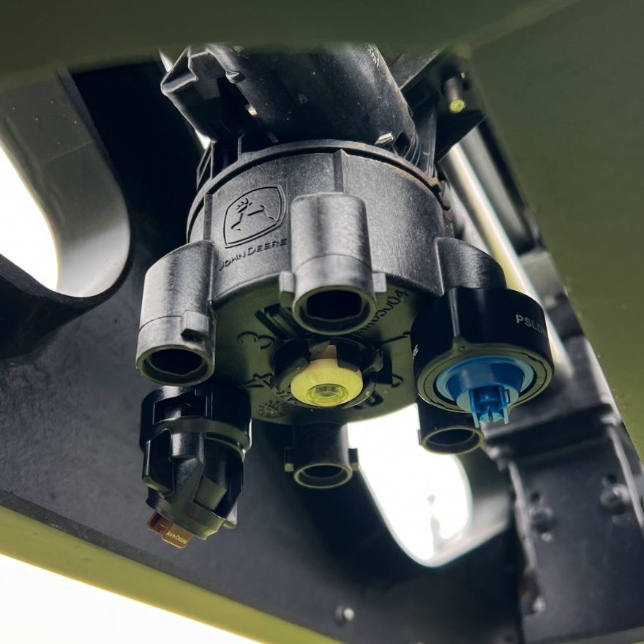
Components
Camera
Processor
Nozzles

Slide 8
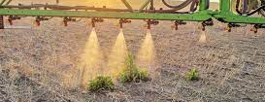
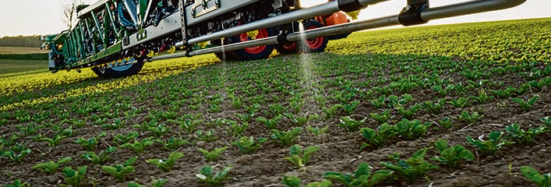
Two types of Targeted spraying
Green on Brown
Green on Green
Bilberry
GreenEye
One Smart Spray
See & Spray Ultimate & Premium
WeedSeeker
Weed-It
See & Spray Select
Notes:
S

Slide 9
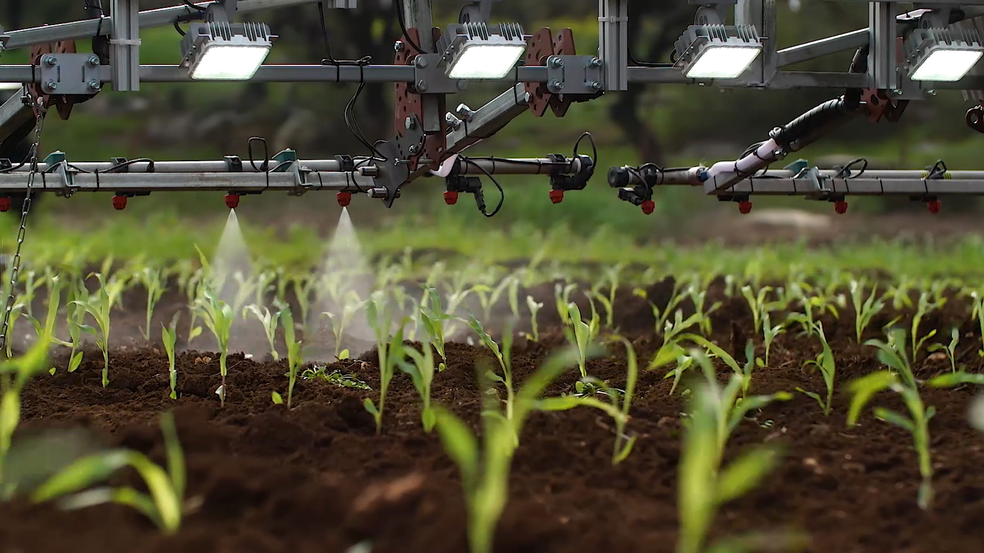
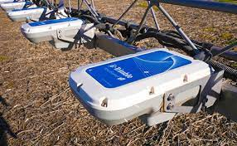
Sensing Technology (Cameras)
Active
Passive
Bilberry
Weed-It
Greeneye
One Smart Spray
See & Spray Select
See & Spray Ultimate and Premium
Weed Seeker
Notes:
S

Slide 10
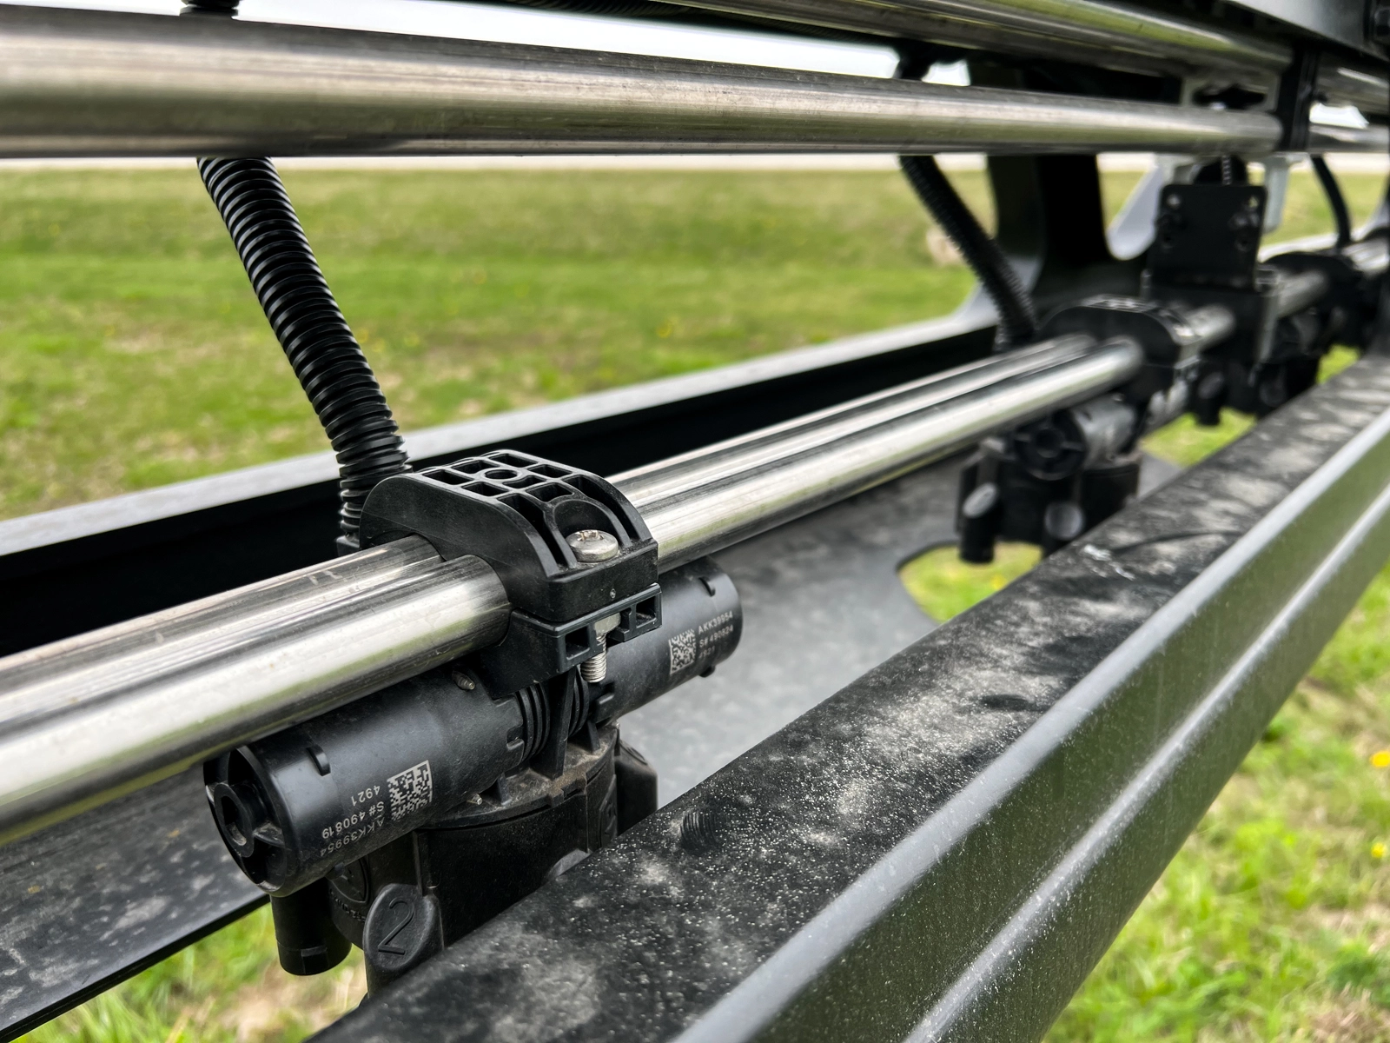
Dual Booms/Tanks
See & Spray Ultimate and GreenEye
Targeted application + broadcast
Avoid some incompatibility/antagonism
Optimize tank conditions
pH, adjuvants, etc.

Slide 11
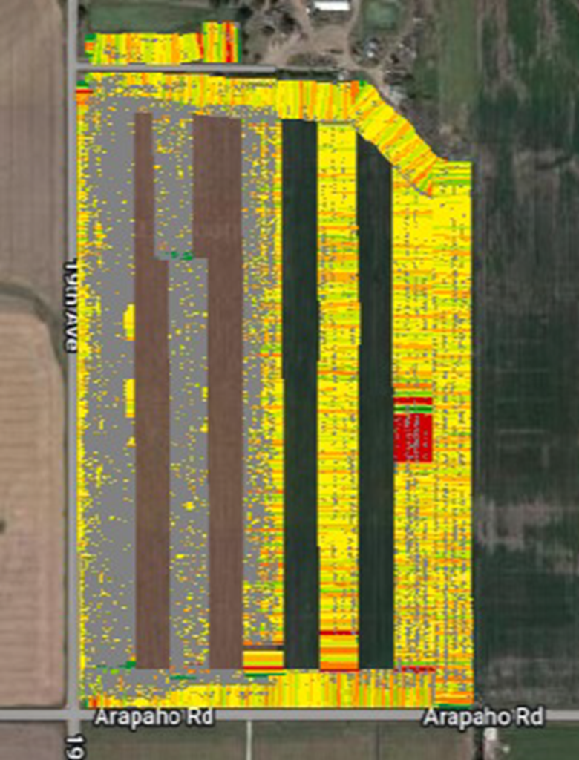
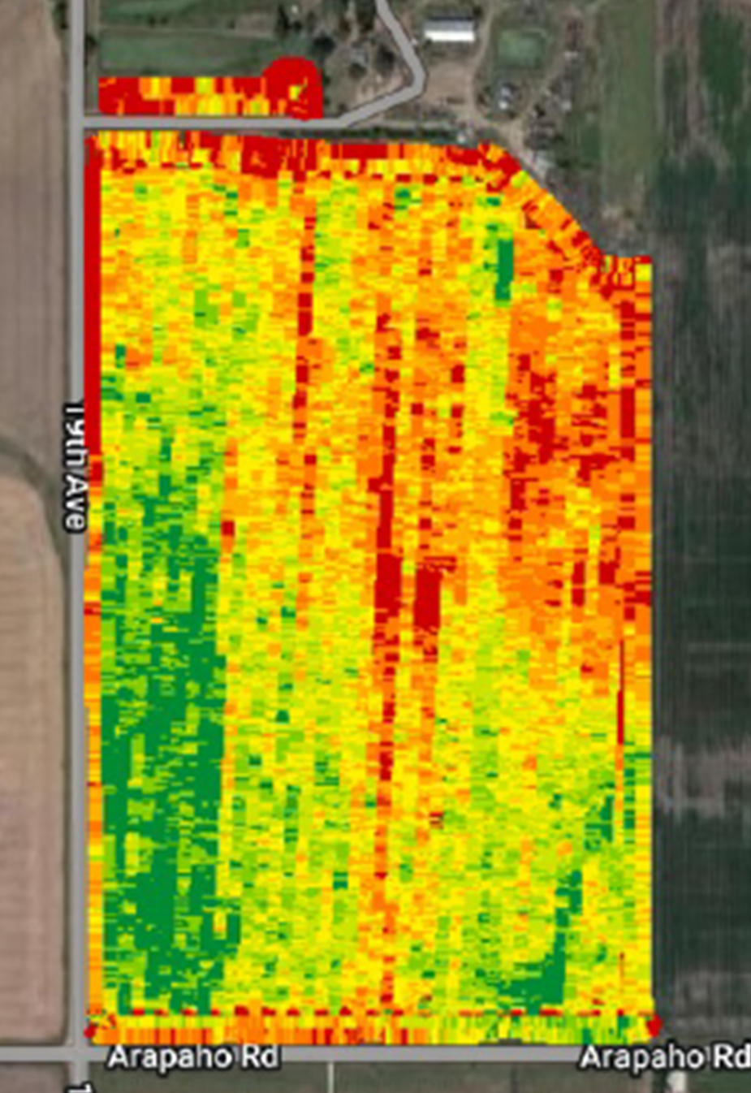
Demonstration
See & Spray treated 55% of area covered
Used 350 gallons less spray solution
Reduced herbicide use by
5.9 gallons Liberty
1.1 gallons NIS
70 lbs AMS

Slide 12
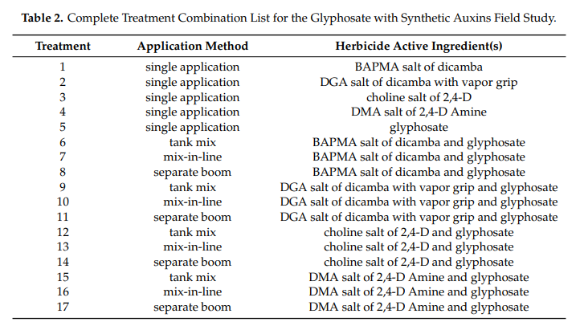
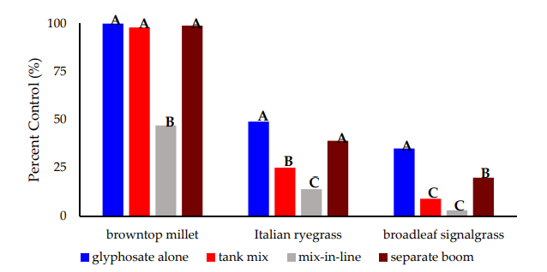
Two-boom systems might reduce antagonism
Merritt et al. 2020

Slide 13
Influence of EPOST Application Method on Weed control14 DTA
BC = Engenia + Select Max
TA = Engenia + Select Max
BCR + TA = Warrant + Engenia + Select Max
Avent et al. 2024

Slide 14
Influence of EPOST Application Method on Soybean Injury 14 DTA
BC = Engenia + Select Max
TA = Engenia + Select Max
BCR + TA = Warrant + Engenia + Select Max
Avent et al. 2024

Slide 15
Which type of targeted application system
(Green on green, green on brown, single tank, dual tank, etc) do you think has the most potential usefulness in your operation?

Slide 16
Factors influencing farmer adoption of targeted sprayers
Collaborators: Haag, Falk Jones, Hock
Study Methods
Qualitative study based on theory of planned behavior and technology acceptance model¹
Initially identified 7 farmers
  Added 10 potential participants based on conversations
Interviewed 11 farmers between May and August
  9 were the primary person making the decision to purchase the sprayer
  2 initiated the purchase of the sprayer
  ¹Mohr and Kuhl 2021

Slide 17
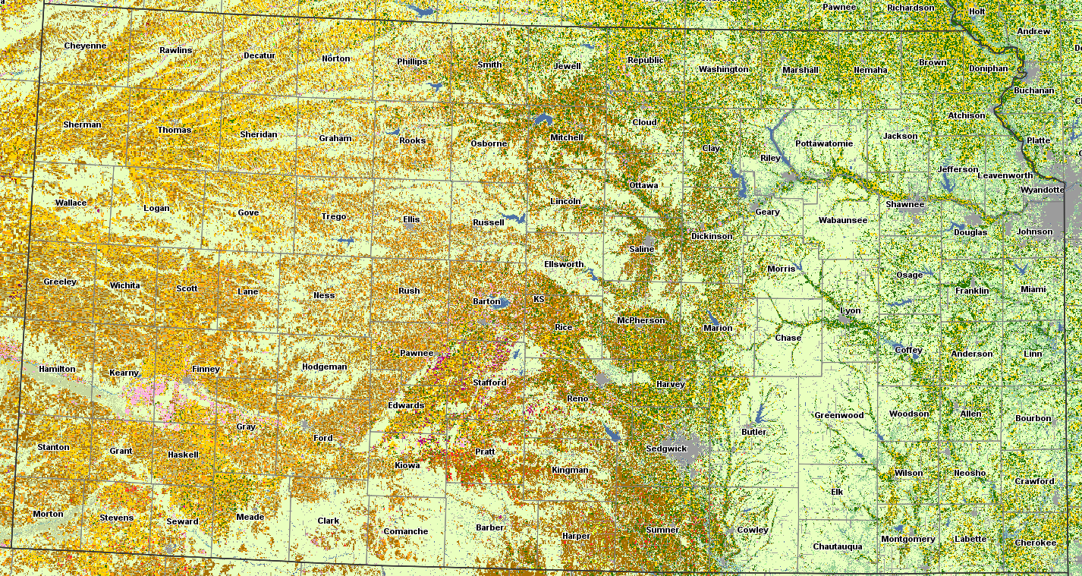
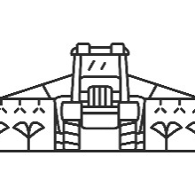
2 See & Spray Ultimate
1 Ultimate, Premium, and Select
2 WEED-IT
2 WEED-IT → See & SprayTM Select
2 See & SprayTM Ultimate
2 See & SprayTM Premium
https://nassgeodata.gmu.edu/CropScape/

Slide 18
Farmer Demographics
Age: 26 to 51 years
Average: 44 years
Acres sprayed total: 7,000 to 350,000
Average: 72,000
Acres sprayed with site-specific technology: 20 to 70%
Average: 44%
7 of 11 participants also own a ‘broadcast only’ sprayer
6 of 11 use a QuickDraw system for tendering, others use similar
2 See & SprayTM Ultimate owners purchased QuickDraw
with the sprayer
Notes:
49
52
51
50
48?
47
46
42?
40
39
26

Slide 19
How much training do you think you will need compared to a non-site-specific sprayer?
  Very little to extensive
  It’s [WEED-IT] actually easier to run than a broadcast sprayer, because there's nothing to do. Just turn it on... You can put anybody on there, as long as they go over the whole field.
  I think you're going to have to have maybe a little bit more skilled operator on there to know when we're going to spray the whole thing, or we're not. But literally, it's three clicks on the screen, on the John Deere [See & SprayTM Premium] to change to broadcast.
  Quite a bit. A lot of it [See & SprayTM Ultimate] is very similar to the current sprayers, but just the technology side and calibrating the cameras, dealing with swapping between each tank or
  combining the tanks, it did take a lot of training.

Slide 20
How does owning a Site-Specific sprayer change your operation?
  It hasn't changed it a lot. Other than we're more efficient with chemicals and I think we're lower cost because of [See & SprayTM Ultimate] overall, even with fees and the added cost of the technology, I think it's paid for itself relatively quickly. The biggest change for us is seeing the results on field bindweed.
  I would put [See & SprayTM Ultimate] towards the high end, maybe an eight [out of 10]. It was definitely so at the end of the year. We like to go and meet with landlords and talk about the year and how different things did. It was definitely a talking point for us, and I think it got a lot of people excited.
  We went to no-till once we got this [Weed-It] machine, just because
  of the efficiencies and the ability to cover acres in a timely fashion
  compared to using tillage. It's not that we were against it [tillage],
  it's just we can be more timely and do a better job getting
  across everything.

Slide 21
What are the greatest benefits of a site-specific sprayer?
See & SprayTM Ultimate owner
The money savings initially is what it'll be long term, I think it's reducing that weed bank and reducing weed pressure and reducing herbicide expense, not just because you're doing see and spray, but because you have less weed pressure.
See & SprayTM Premium owner
So I think number one is the environmental impact
I think guys are going to be more apt to go out and spray stuff earlier.
See & SprayTM Select owner
Overall efficiencies of your time

Slide 22
What are the greatest limitations of a site-specific sprayer?
See & SprayTM Ultimate & Premium owners
Well, coverage was one we've talked about that a little bit. It's not bad, it's just it's not
as good as being able to shoot it from both sides.
Speed for some guys is probably a limitation
Sometimes the only time we can spray is at night, so that's probably one of the biggest limitations.
Dust and shading a little bit certain times of the day, if the sun's over here on this side, this sides run kind of in the dark, in the shade, and then it gets a little dust, and it makes those cameras not want to read.
Cost is the biggest barrier, or because you gotta buy [the subscription fee].
It's like going over a terrace. When it comes up [over the required height], it sprays that.
And so you're going to spray more [of a terraced field]
See & SprayTM Select and WEED-IT owners
I think we have to cover it at least twice more in a year than we do
[with broadcast sprays]

Slide 23
Summary – Opportunities
Herbicide savings
  Generally most important
Time savings
  More important for fallow/green-on-brown applications
    Fewer loads either equal to or better than faster driving speed
Improved weed control
  Especially long-term
Reduced crop injury
  For green-on-green
Conserve water resources
  Especially where precipitation <20”

Slide 24
Summary – Obstacles
Staying out of fallback mode
  Dust
        One participant arranged to have additional cameras mounted on front of machine
  Shadows/light
        More important for allowing green-on-green sprayers to run after dark
    Boom height
        Uneven terrain
Coverage
  One participant addressed by running opposite directions in sequential passes
  Experimenting with nozzles
Trust that cameras will detect small weeds
Grain sorghum algorithm
  Corn will work
Economics
  Initial price
  Used sprayer values
  Custom applicator

Slide 25
Other considerations
What portion of acres are suited for targeted application??
More complicated tendering in dual-tank systems
Regulatory questions
  What rate is legal?
  Mitigation points
-Other uses?

Slide 26
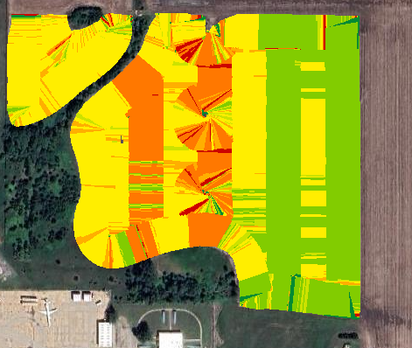
PRESCRIPTION HERBICIDE APPLICATIONS
Based residual herbicide applications on:
Soil properties (little variation)
Previous as applied map
Broadcast – 64 fl oz
Based on weed map – 64 or 56 fl oz
Based on soil map – 64 or 60 fl oz
Based on both – 64, 60, or 56 fl oz

Slide 27
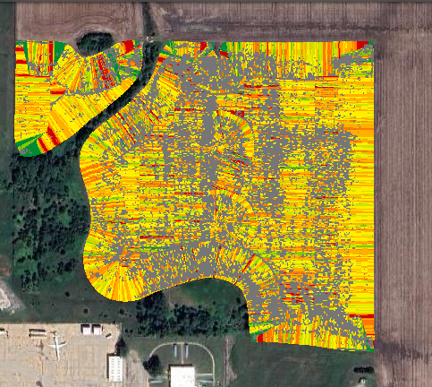
As applied map
Areas of no application correspond with areas with no weeds

Slide 28
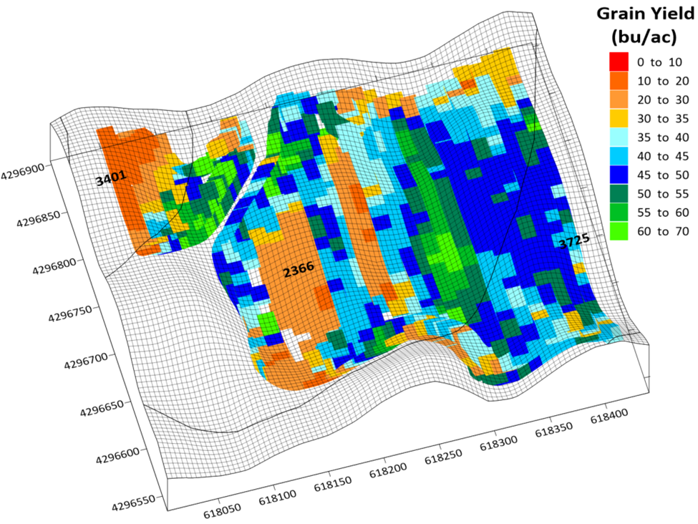
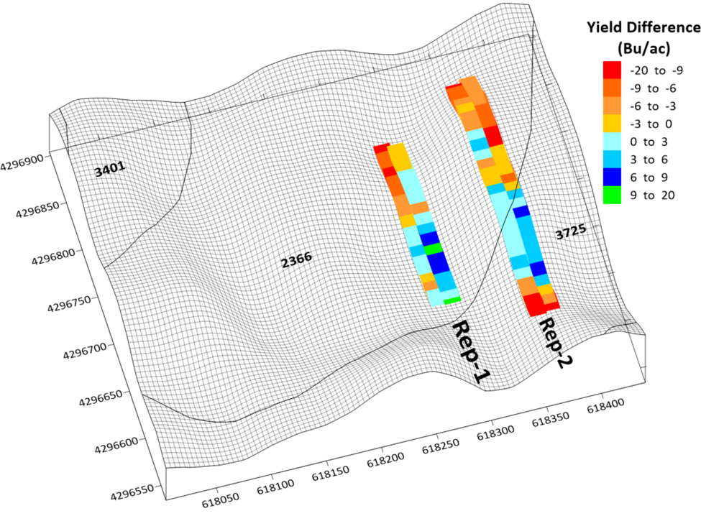
Variable-rate residual herbicide application based on weed distribution and soil texture
Caldieraro et al 2024

Slide 29
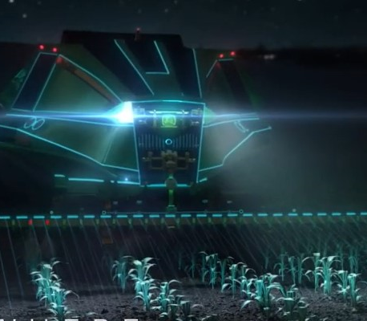
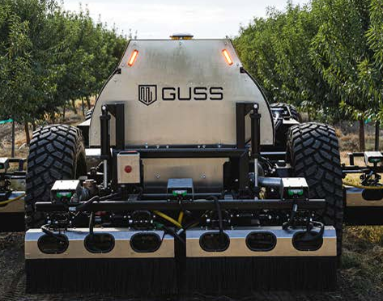
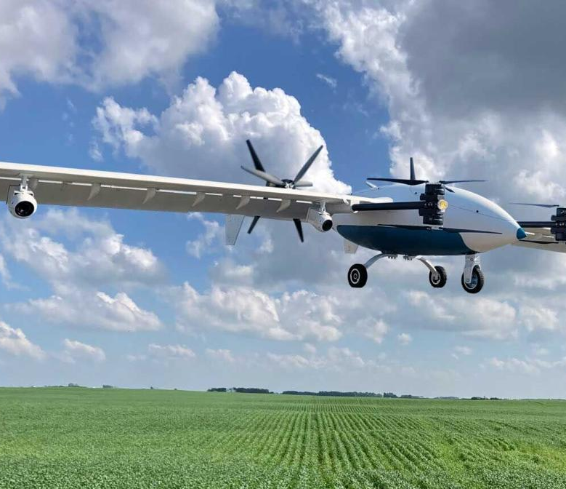
What does the future hold?
https://www.youtube.com/@HorizonAgTurf
www.deere.co.nz
www.precision.ai

Slide 30
Let’s Connect
slancaster@ksu.edu
@KStateWeedSci
K-State Weed Science
kstateweedsci
War Against Weeds podcast
eUpdate.agronomy.ksu.edu

